Slide 1
A STUDY ON
“IDENTITY –BASED DATA OUTSOURCING WITH COMPREHENSIVE AUDITING IN CLOUDS”
Submitted By
A.SAI KUMAR REDDY
Regd.No: 193110001
Dept: MSC. Computer Science

Slide 2
ABSTRACT
Remote data integrity checking (RDIC) enables a data storage server,.
We formalize ID-based RDIC and its security model including security

Slide 3
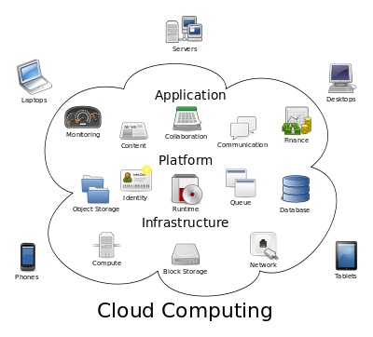

INTRODUCTION
Cloud computing
Computing is the use of computing resources hardware and software
cloud ing remote services with a users data software and computation

Slide 4
Characteristics and Services Models
On-demand self-service:
Broad network access:
Resource pooling:
Rapid elasticity:
Measured service:

Slide 5
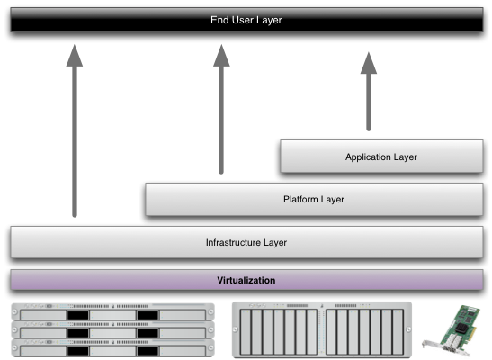
Characteristics of cloud computing
Services Models:
Cloud Computing comprises three different service models,
Structure of service models

Slide 6
Benefits of cloud computing
Achieve economies of scale
Streamline processes
Reduce capital costs
Improve accessibility
Monitor projects more effectively
Less personnel training is needed

Slide 7
Advantages
Price
Security
Performance
Scalability
Uptime
Control
Traffic

Slide 8
ORGANIZATION PROFILE COMPANY PROFILE
Performance
Pioneering efforts
Client satisfaction
Innovative concepts
Constant Evaluations
Improvisation
Cost Effectiveness

Slide 9
FEASIBILITY STUDY
ECONOMICAL FEASIBILITY
This study is carried out to check the economic impact that the system

Slide 10
TECHNICAL FEASIBILITY
This study is carried out to check the technical feasibility
SOCIAL FEASIBILITY
The aspect of study is to check the level of acceptance of the system

Slide 11
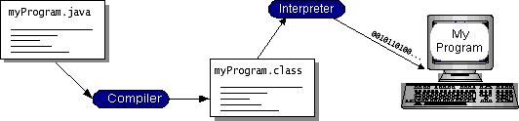
Software Environment
Java Technology
Simple
Object oriented
Portable
Distributed
High performance
Dynamic
Secure

Slide 12
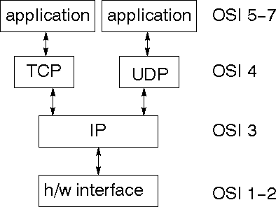
Networking
TCP/IP stack
The TCP/IP stack is shorter than the OSI one:
IP datagram’s
The IP layer provides a connectionless and unreliable delivery system.
It considers each datagram independently of the others.

Slide 13
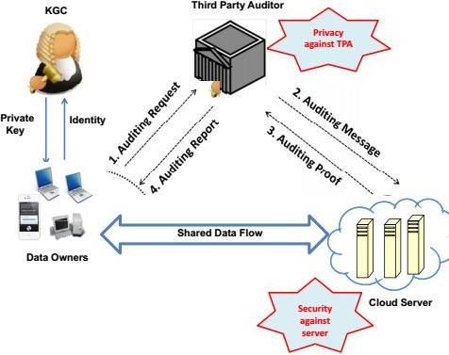
SYSTEM DESIGN

Slide 14


Data Owner:
Register
KGC Approval
Login
Yes
Check
No
Unauthorized user
Upload Files
View Uploaded Files
Audit Request
Verify Files
End process

Slide 15


TPA:
Register
Yes
Check
No
Unauthorized user
View Audit Request
Send Request To Cloud
View Cloud Response
Verify Files
Send Audit Report
End process

Slide 16


CLOUD:
Cloud Login
No
Yes
Check
Unauthorized user
View Audit Request
Generate Proof
View all files
End process

Slide 17
KGC:
KGC
No
Yes
Check
Unauthorized user
View Owners List
Generate Unique ID
End process

Slide 18
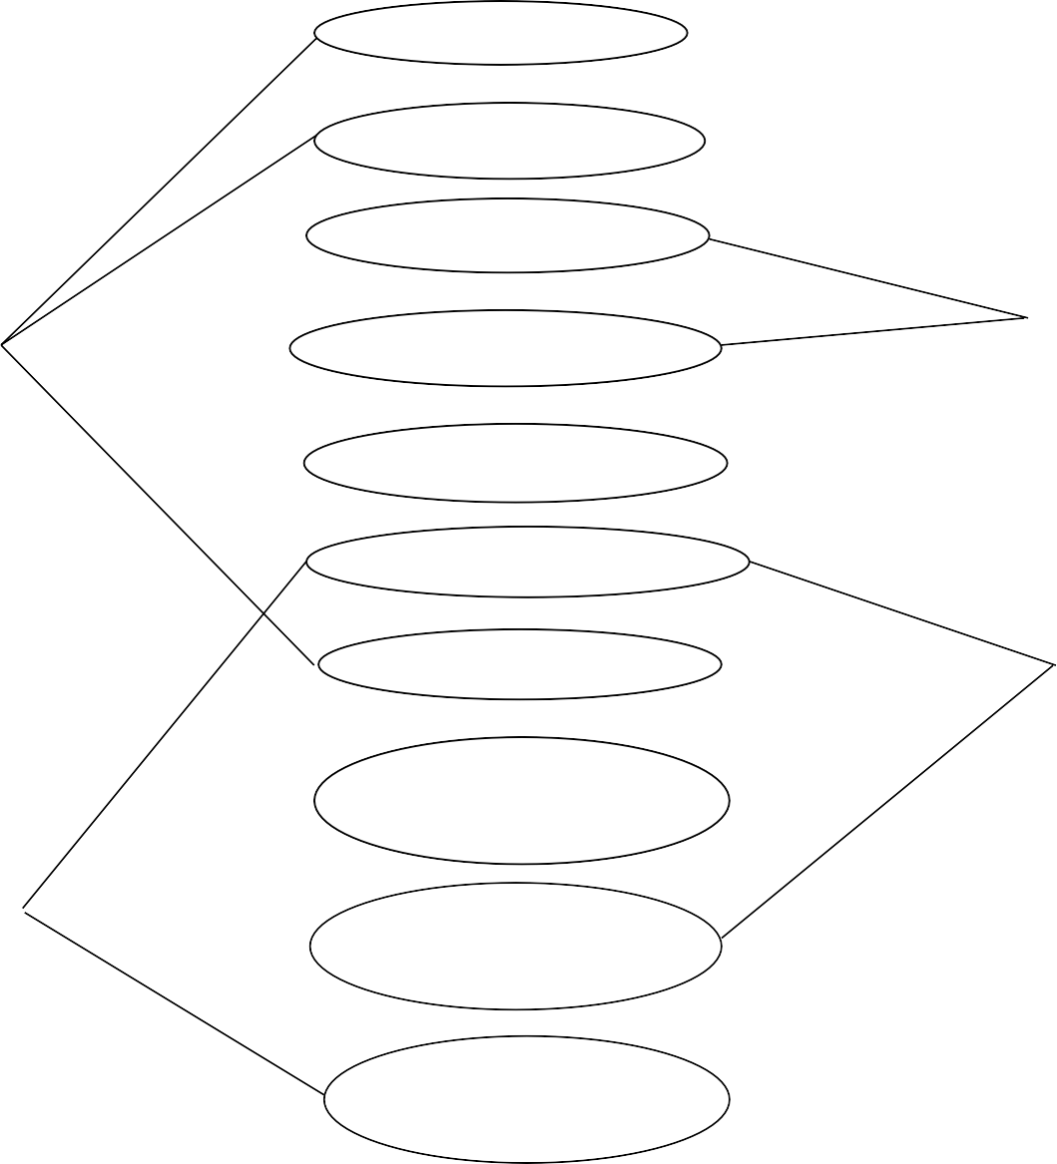



USE CASE DIAGRAM:
Login Authorize Owners
Send Private Key
KGC
Upload Files
View files Send Audit Request
View Audit Request & send to cloud
View request & send proof
TPA
Verify Proof & send to DO
Verify File
Logout

Slide 19
CLASS DIAGRAM:
Data Owner
Register Login
Upload Files () View Uploaded Files () Audit Request () Verify Files ()
KGC
Login
Authorize Data Owner () Send Private Key ()
TPA
Login
View Request () Send Request to Cloud () Receives Response () Send Audit Report ()
Cloud
Login
View Audit Request () Generate Proof () Send to TPA () View Files in Cloud ()

Slide 20




SEQUENCE DIAGRAM:
Data Owner
KGC
TPA
Cloud
Register
Login
Login
Authorize owner
Login
View Request
View Files

Slide 21


ACTIVITY DIAGRAM:
Start
Cloud
KGC
TPA
Data Owner
Login
Login
Login
Register
View Request
Authorize Data Owners
View audit Request
Login
Send Proof
Send Private Key
Send Request to Cloud
Upload Files
View files
View Files & Send Audit request
Receives Proof & verify
Receives Audit report
Send Audit Report
Verify Files

Slide 22
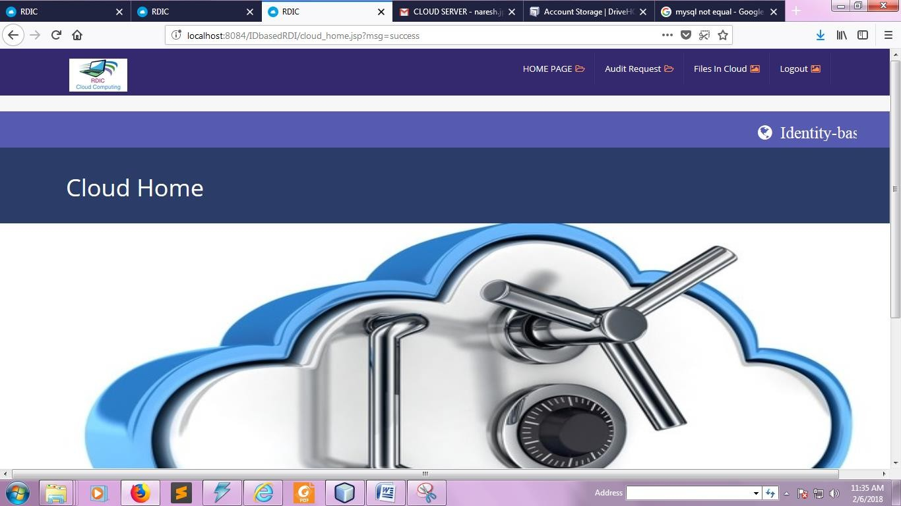
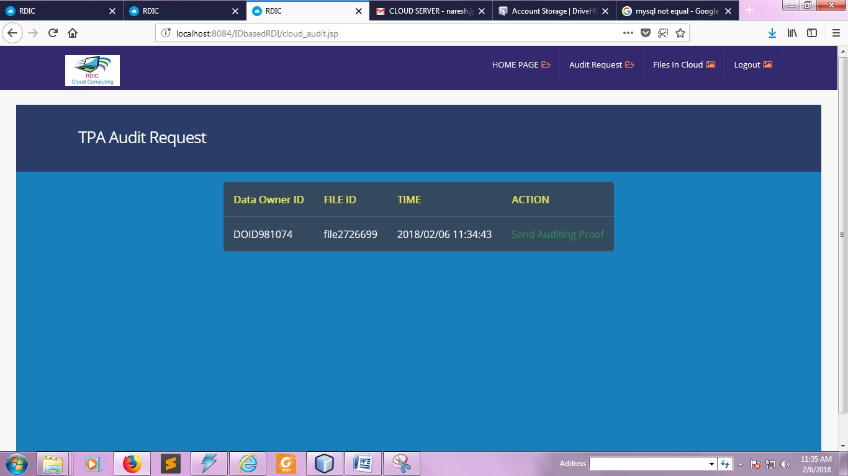

Slide 23
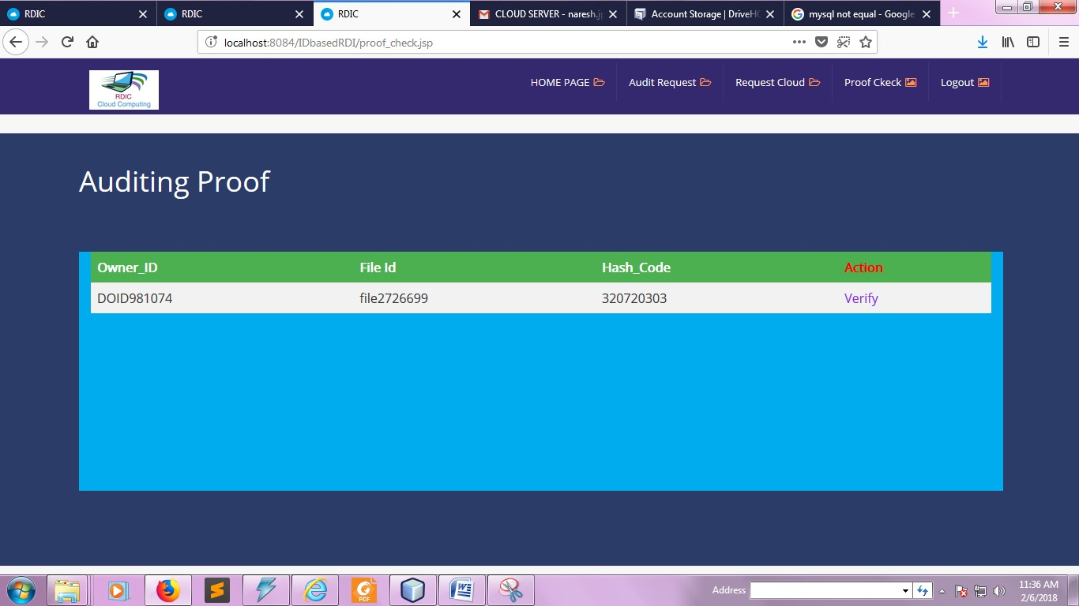
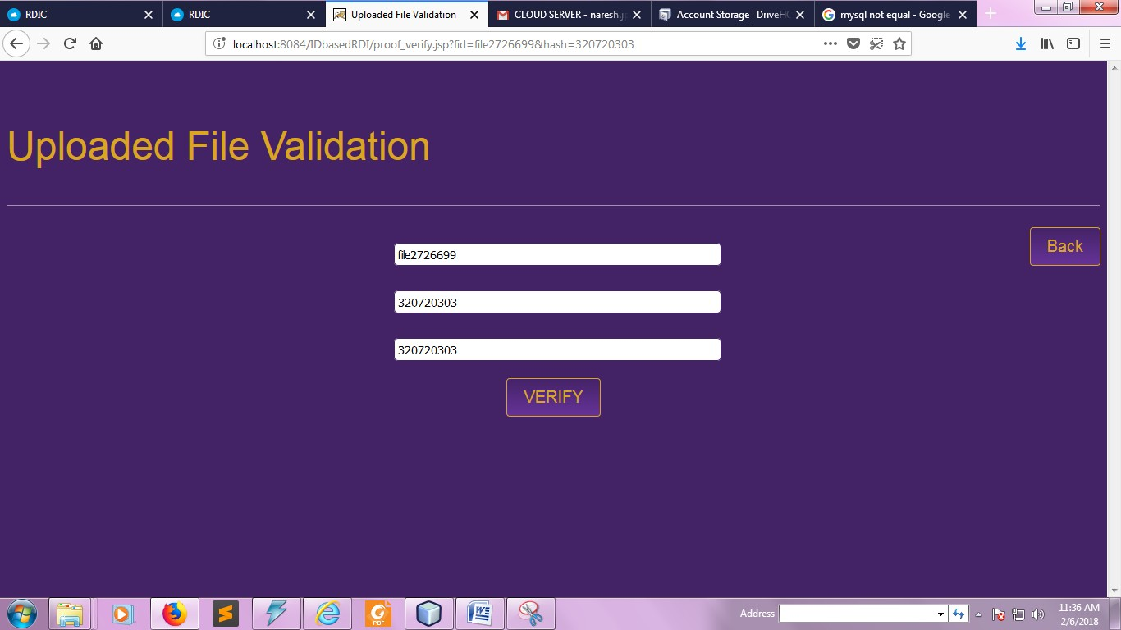

Slide 24
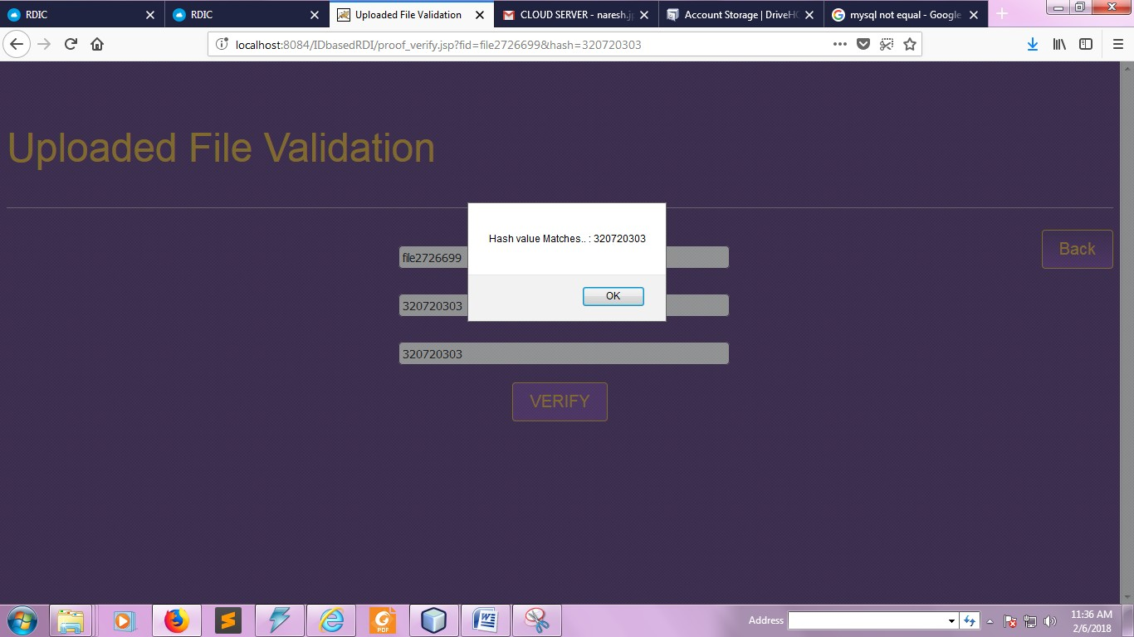
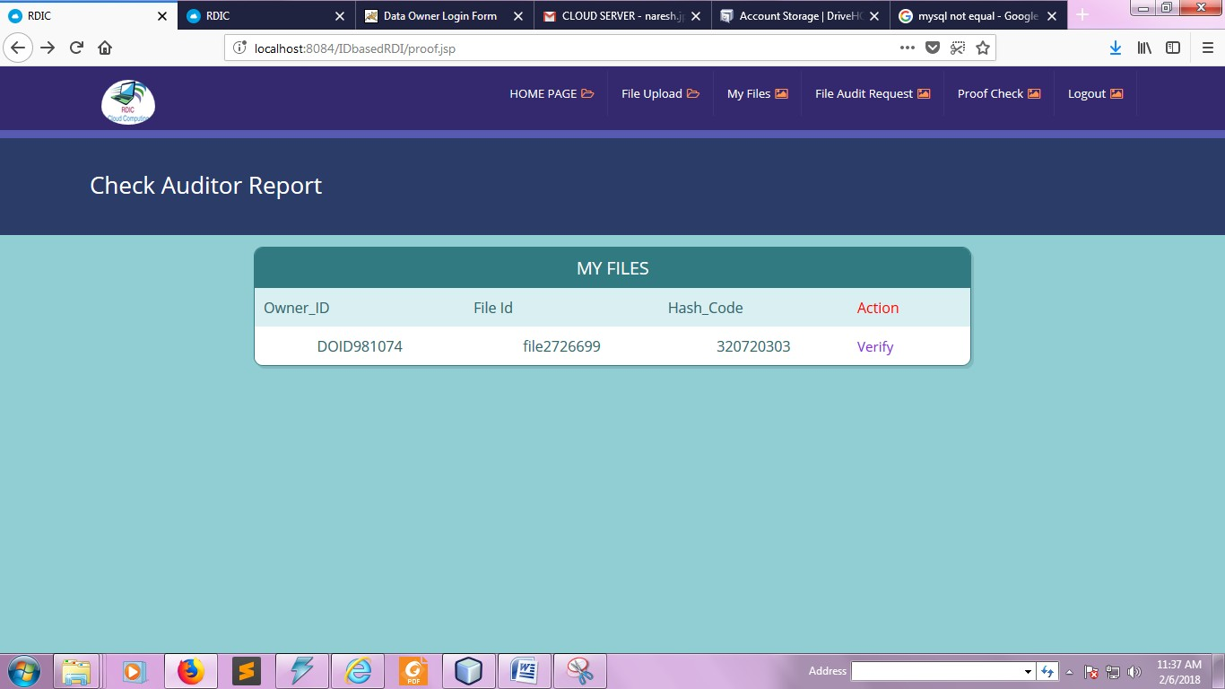

Slide 25
Unit Testing:
Test objectives
All field entries must work properly.
Pages must be activated from the identified link.
The entry screen, messages and responses must not be delayed.
Features to be tested
Verify that the entries are of the correct format
No duplicate entries should be allowed
All links should take the user to the correct page.

Slide 26
Conclusion
In this page, We investigated a new primitive called identity-based remote
Both the numerical analysis and implementation demonstrated

Slide 27
THANK YOU SIR

